Slide 1
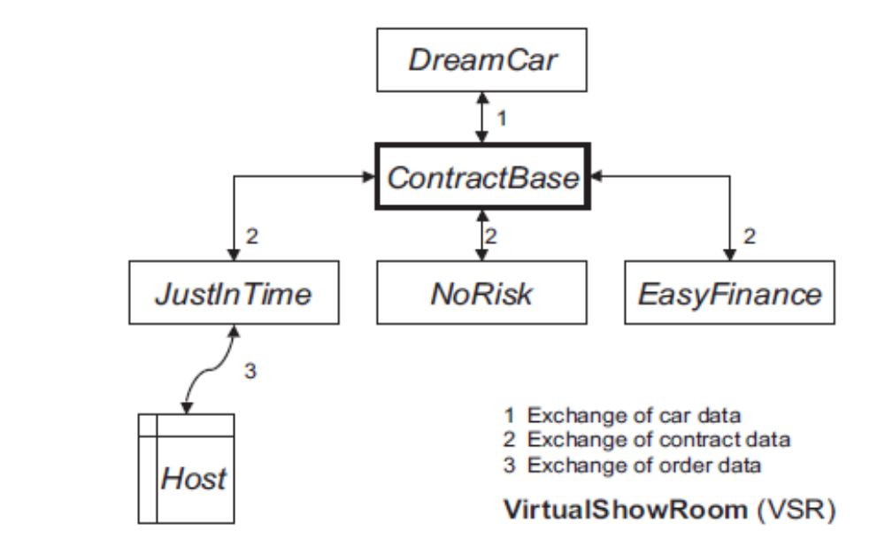
Chapter 2 Fundamentals of Testing
A car manufacturer develops a new electronic sales support system called VirtualShowRoom (VSR).
Architecture of the VSR-System

Slide 2
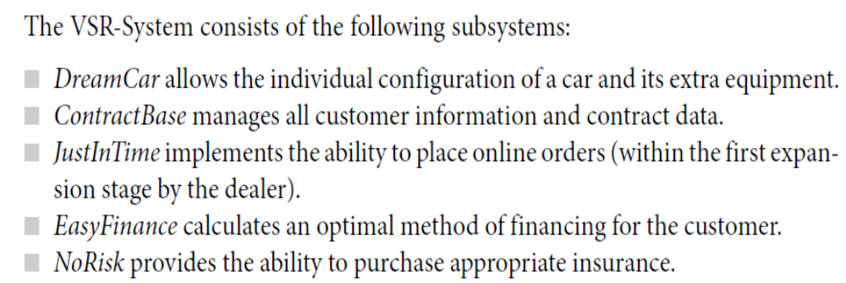

Slide 3
Chapter 2 Fundamentals of Testing
2.1 Terms and Motivation
During the construction of an industry product, the parts and the final product are usually examined to make sure they fulfill the given requirements, that is, whether the product solves the required task.
Testing contributes to reducing the risk of using the software because defects can be found in testing. Testing and test documentation are often defined in contracts, laws, or industrial or organizational standards.
2.1.1 Error, Defect, fault,and Bug Terminology
A failure means that a given requirement is not fulfilled; it is a discrepancy between the actual result or behavior and the expected result or behavior.

Slide 4
Chapter 2 Fundamentals of Testing
To describe the event when a user experiences a problem, [IEEE610.12] uses the term failure. However, other terms, like problem, issue,and incident, are often used.
The cause of a defect is an error or mistake by a person—for example, defective programming by the developer.
2.1.2 Testing Terms
To be able to correct a defect or bug, it must be localized in the software. In practice, correcting defects often introduces one or more new defects. The new defects may then introduce failures for new, totally different inputs.
Debugging is often equated with testing, but they are entirely different activities.

Slide 5
Chapter 2 Fundamentals of Testing
Debugging is the task of localizing and correcting faults or errors. The goal of testing is the (more or less systematic) detection of failures (that indicate the presence of defects). Testing involves test date, planning, test case,test object,test conditions(test requirements),test scenarios (Several test cases combined together,the result of one test case is used as the starting point for the next test case),test suite, comparing the actual and expected behaviors of the test object...... Testing software has different purposes:
■ Executing a program to find failures
■ Executing a program to measure quality(function and feature)
■ Executing a program to provide confidence
■ Analyzing a program or its documentation to prevent failures

Slide 6
Chapter 2 Fundamentals of Testing
The following terms describe the different ways tests are named:
Test objective;
test type；
Test technique；
Test object：(for example, a GUI test or DB test )；
Test level；
Test person；
Test extent：A test is named after the level of extent (for example, regression test, full test).
2.1.3 Software Quality
Software testing contributes to improvement of software quality. This is done by identifying defects and subsequently correcting them.

Slide 7
Chapter 2 Fundamentals of Testing
Software quality is more than just the elimination of failures found during testing. According to the ISO/IEC(the IEC - International Electrotechnical Commission) Standard 9126-1 [ISO 9126],software quality comprises the following factors: functionality, reliability(fault tolerance, and recoverability,MTBF(Mean Time Between Failures)), usability, efficiency, security, portability and maintainability.
Testing must consider all these factors, also called quality characteristics or quality attributes.
Quality characteristics must therefore be prioritized. The quality specification is used to determine the test intensity for the different quality characteristics.
2.1.4 Test Effort
Testing cannot prove the absence of faults. In practice, a

Slide 8
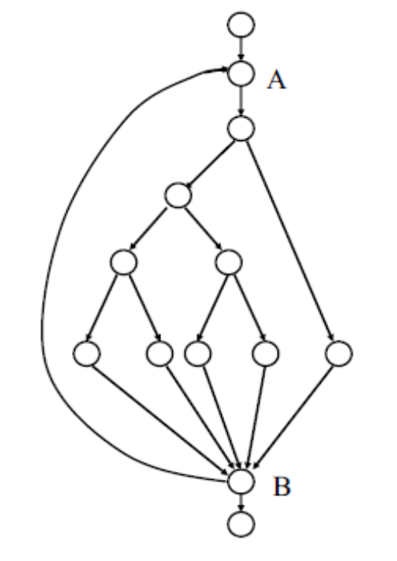
Chapter 2 Fundamentals of Testing
complete or exhaustive test is not feasible. Due to combinational effects, the outcome of this is an almost infinite number of tests. At a loop limit of a maximum of 20 cycles and considering that all links are independent, the outcome is the following calculation, whereby 5 is the number of possible ways within the loop:
5²⁰ + 5¹⁹ + 5¹⁸ + … + 5¹

Slide 9
Chapter 2 Fundamentals of Testing
It is only possible to consider a part of all imaginable test cases. But even so, testing still accounts for a large portion of the development effort.
■ For some major projects with more than 10 person-years’ effort, coding and testing together used 40%, and a further 8% was used for the integration. At test-intensive projects (for example, safety-critical systems),the testing effort increased to as much as 80% of the total budget.
■ In one project, the testing effort was 1.2 times as high as the coding effort, with two-thirds of the test effort used for component testing.
■ For another project at the same software development company, the system test cost was 51.9% of the project.

Slide 10
Chapter 2 Fundamentals of Testing
For Failure risk to test:Testing should continue as long as costs of finding and correcting a defect are lower than the costs of failure. Thus, the test effort is always dependent on an estimation of the application risk. In the case of the VSR-System, If the system calculates a wrong price, the customer can insist on that price and it is a risk.
If there is a high risk for failures by a system or subsystem, there must be a greater testing effort than for less critical (sub)systems.
The risk assessment must be done for the individual system parts, or even for single error possibilities. If there is a high risk for failures by a system or subsystem, there must be a greater testing effort than for less critical (sub)systems.Different test techniques are applied for software of different integrity levels.

Slide 11
Chapter 2 Fundamentals of Testing
There exist many different methods and techniques for testing software. Every technique especially focuses on and checks particular aspects of the test object. There is no test technique that is equally well suited for all aspects.
The testing effort can grow very large:Test managers face the dilemma of possible test cases and test case variants quickly becoming hundreds or thousands of tests.
The test manager usually has the worst position in this “game.” Often there is only a small time window just before delivery for executing the test cases and very few testers are available to run the test. It is certain that the test manager does not have the time and resources for executing an “astronomical” amount of test cases.
Besides the adherence to a fundamental test process, further quality assurance activities must be accomplished

Slide 12
Chapter 2 Fundamentals of Testing
such as, reviews. Additionally, a test manager should learn from earlier projects and improve the development and testing process.
2.2 The Fundamental Test Process
To accomplish a structured and controllable software development effort, software development models and development processes are used. Many different models exist:V-model,XP,prototype,scrum,spiral,incremental.....
This means that the “content” of the development task testing must be split into smaller subtasks, as follows: test planning and control,test analysis and design, test implementation and execution, evaluation of test exit criteria and reporting, and test closure activities.
Although illustrated sequentially, the activities in the test

Slide 13
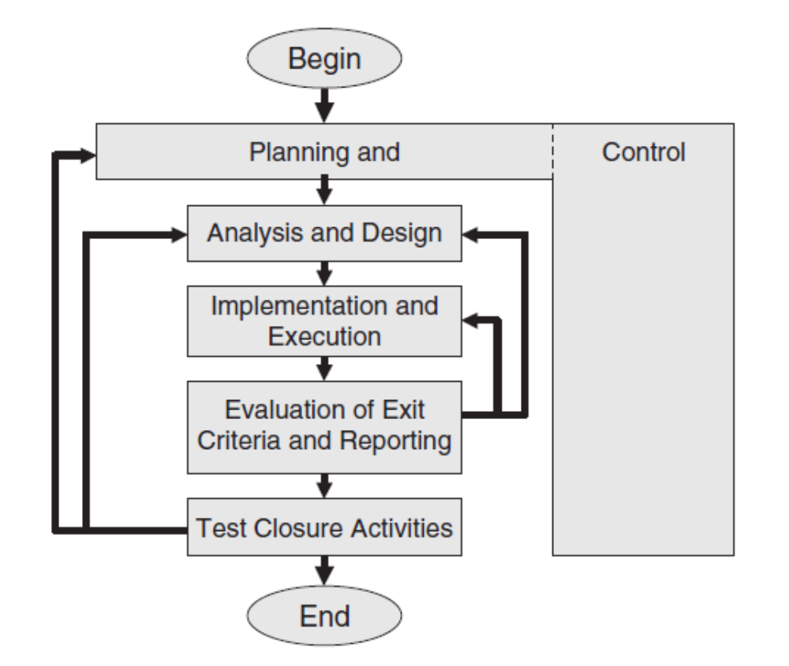
Chapter 2 Fundamentals of Testing
process may overlap or take place concurrently. Test activities also need to be adjusted to the individual needs of each project. The test process described here is a generic one.

Slide 14
Chapter 2 Fundamentals of Testing
2.2.1 Test Planning and Control(Refer to the unit test plan)
Execution of such a substantial task as testing must not take place without a plan. Planning of the test process starts at the beginning of the software development project. As with all planning, during the course of the project the previous plans must be regularly checked, updated, and adjusted.
test planning involves resources,tasks,training programs,organizational structure,test control,test infrastructure, testware(test doc,test script...), priorities, based on risk assessment,test coverage,exit criteria,test tools,test harnesses (or test beds),......
The intensity of testing depends very much on the test techniques that are used and the test coverage that must be achieved.

Slide 15
Chapter 2 Fundamentals of Testing
2.2.2 Test Analysis and Design
1) Analysing test specification.The first task is to review the test basis, i.e., the specification of what should be tested. The specification should be concrete and clear enough to develop test cases. The basis for the creation of a test can be the specification or architecture documents, the results of risk analysis, or other documents produced during the software development process.
For example, a requirement may be too imprecise in defining the expected output or the expected behavior of the system, so testability of this requirement is insufficient. Therefore it must be reworked. Determining the preconditions and requirements to test case design should be based on an analysis of the requirements, the expected behavior, and the structure of the test object.

Slide 16
Chapter 2 Fundamentals of Testing
As with analyzing the basis for a test, the test object itself also has to fulfill certain requirements to be simple to test.
The results of this analysis are also used to state and prioritize the test conditions based on the general objectives of the test. The test conditions state exactly what shall be tested. This may be a function, a component, or some quality characteristic.
2) Analysing test strategy. The test strategy determined in the test plan defines which test techniques shall be used. The test strategy is dependent on requirements for reliability and safety. If there is a high risk of failure for the software, very thorough testing should be planned. If the software is less critical, testing may be less formal.
In the test specification, the test cases are then developed

Slide 17
Chapter 2 Fundamentals of Testing
using the test techniques specified. Techniques planned previously are used, as well as techniques chosen based on an analysis of possible complexity in the test object.
It is important to ensure traceability between the specifications to be tested and the tests themselves. It must be clear which test cases test which requirements and vice versa.
Even the traceability of requirement changes to the test cases and vice versa should be verified.
3) Design test case. Specification of the test cases takes place in two steps. Logical test cases have to be defined first. After that, the logical test cases can be translated into concrete, physical test cases, meaning the actual inputs are selected (concrete test cases).

Slide 18
Chapter 2 Fundamentals of Testing
the opposite sequence is possible:from concrete to the general logical test cases. This procedure must be used if a test object is specified insufficiently and test specification must be done in a rather experimental way (exploratory testing). Development of physical test cases is part of the test implementation.
The test cases can be determined from the test object’s specification(black box test design techniques or white box test design techniques). Furthermore, before test execution, it must be defined which results and behaviors are expected. The results include outputs,changes to global (persistent) data and states, and any other consequences of the test case.

Slide 19
Chapter 2 Fundamentals of Testing
To define the expected results, the tester must obtain the information from some adequate source. In this context, this is often called an oracle,or test oracle(A source of comparison between expected and actual results). A test oracle is a mechanism for predicting the expected results. The specification can serve as a test oracle. There are two main possibilities:
■ The tester derives the expected data based on the specification of the test object.
■ If functions doing the reverse action are available, they can be run after the test and then the result is verified against the original input. An example of this scenario is encryption and decryption of data.

Slide 20
Chapter 2 Fundamentals of Testing
Test cases can be differentiated by two criteria:
■ First are test cases for examining the specified behavior, output, and reaction. Included here are test cases that examine specified handling of exception and error cases (negative test). But it is often difficult to create the necessary preconditions for the execution of these test cases (for example, capacity overload of a network connection).
■ Next are test cases for examining the reaction of test objects to invalid and unexpected inputs or conditions, which have no specified exception handling.
The following example is intended to clarify the difference between logical and concrete (physical) test cases:

Slide 21
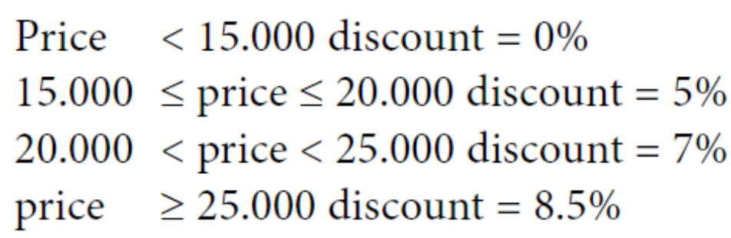
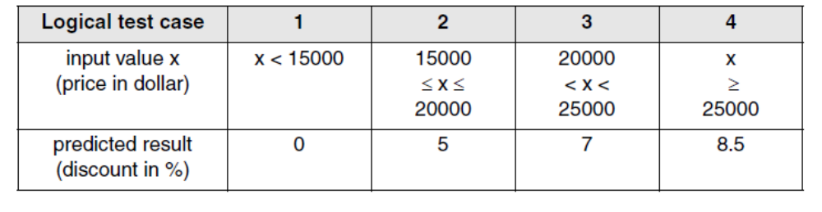
Chapter 2 Fundamentals of Testing
Using the sales software, the car dealer is able to define discount rules for his salespeople: With a price of less than $15,000, no discount shall be given. For a price of $20,000, 5% is OK. If the price is below $25,000, a 7% discount is possible. For higher prices, 8.5% can be granted.From this, the following cases can be derived:

Slide 22
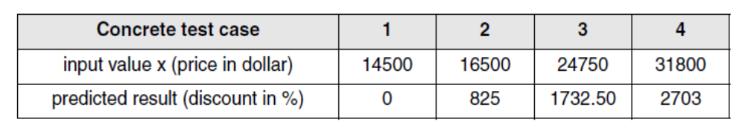
Chapter 2 Fundamentals of Testing
The test infrastructure should already be assembled, integrated, and verified as much as possible at this time.
2.2.3 Test Implementation and Execution
Test Implementation:Here, logical test cases must be transformed into concrete test cases; all the details of the environment (test infrastructure) must be set up. The tests must be run and logged. The priority of the test cases (see section 6.2.3), decided during test planning, must be taken into account. The test cases should also be grouped into test suites or test scenarios for efficient test execution and easier understanding.

Slide 23
Chapter 2 Fundamentals of Testing
In many cases specific test harnesses or test beds(drivers, stubs,simulators, etc.)must be programmed, built, acquired, or set up as part of the test environment before the test cases can be executed. Because failures may also be caused by defects in the test harness, the test environment must be checked to make sure it’s working correctly.
Test Execution:The recommendation is to start test execution with the examination of the test object’s main functionality (smoke test). Test execution must be exactly and completely logged. The test log must document who tested which parts,when, how intensively, and with what results.If a difference shows up between expected and actual results during test execution, it must be decided when evaluating the test logs if the difference really indicates a failure.

Slide 24
Chapter 2 Fundamentals of Testing
A rough analysis of possible causes must be made. This analysis may require the tester to specify and execute additional test cases.
The cause for a failure can also be an erroneous or inexact test specification,problems with the test infrastructure or the test case, or an incorrect test execution.
In addition to reporting discrepancies between expected and real results, test coverage should be measured.
Based on the severity of a failure (see section 6.6.3), a decision must be made about how to prioritize defect corrections. After defects are corrected, the tester must make sure the defect has really been corrected and that no new defects have been introduced.
2.2.4 Test Evaluation and Reporting

Slide 25
Chapter 2 Fundamentals of Testing
Satisfy test coverage criteria:During test evaluation and reporting, the test object is assessed against the set test exit criteria(often test coverage criteria) specified during planning. This may result in normal termination of the tests if all criteria are met, or it may be decided that additional test cases should be run or that the criteria were too hard.
For example, it could be specified that a test is considered good enough after execution of 80% of the test object statements. Appropriate tools should be used to collect such measures, or metrics.
If one test exit criterion is not fulfilled after all tests are executed, further tests must be executed and other examination techniques should be used, such as, for example, static analysis.

Slide 26
Chapter 2 Fundamentals of Testing
A further case of not meeting test exit criteria may occur if the specified criterion is impossible to fulfill in the specific case. If, for example, the test object contains dead code.
In addition to test coverage criteria, other criteria can be used to define the test’s end. A possible criterion is the failure rate. rate, for example,the average number of new failures per testing hour over 10 weeks.
Correct defect: When deciding to stop testing this way it must be considered that some failures can have very different effects. The failures found during the test should be repaired, after which a new test becomes necessary. The project plan should provide for the appropriate time buffers and personnel resources.
In practice, the end of a test is often defined by factors that have no direct connection to the test: time and costs.

Slide 27
Chapter 2 Fundamentals of Testing
When the test criteria are fulfilled or a deviation from them is clarified,a test summary report should be written for the stakeholders.
2.2.5 Test Closure Activities
It is a pity that these activities, which should be executed during this final phase in the test process, are often left out. The experience gathered during the test work should be analyzed and made available for future projects.The following data should be recorded:
■ When was the software system released?
■ When was the test finished or terminated?(unit test end..)
■ When was a milestone reached(unit testing or..) or a maintenance release completed?

Slide 28
Chapter 2 Fundamentals of Testing
Important information for evaluation can be extracted by asking the following questions:
■ Which planned results were achieved and when—if at all?
■ Which unexpected events happened (reasons and how they were met)?
■ Are there any open problems and change requests? Why were they not implemented?
■ How was user acceptance after deploying the system?
If these findings are used in subsequent projects, continuous process improvement is achieved. A further closure activity is the “conservation” of the testware for the future. A major part of the test effort during maintenance can be avoided if the testware (test cases, test logs, test infrastructure, tools, etc.) is still available.

Slide 29
Chapter 2 Fundamentals of Testing
It can then be adapted instead of being constructed from scratch, and it can also be successfully used for projects having similar requirements.
2.3 The Psychology of Testing
“Can the developer test his own program?” is an important and frequently asked question. Developers would rather not find any defects in their own program text.
An independent testing team is beneficial for test quality and comprehensiveness.
The tester must, however, acquire the necessary knowledge about the test object in order to create test cases, which takes time. But the tester typically has more testing knowledge. The way this reporting and communicate are done can contribute to cooperation between developers and testers.

Slide 30
Chapter 2 Fundamentals of Testing
Often,failures found during testing are not reproducible in the development environment for the developers. Thus, in addition to a detailed description of failures, the test environment must be documented in detail so that differences in the environments can be detected, which can be the cause for the different behavior.
Developers should know the basics of testing and testers should have a basic knowledge of software development. This eases the understanding of the mutual tasks and problems.
2.4 General Principles of Testing
Principle 1:
Testing shows the presence of defects, not their absence.

Slide 31
Chapter 2 Fundamentals of Testing
Principle 2:
Exhaustive testing is impossible.
Principle 3:
Testing activities should start as early as possible.
Principle 4:
Defect clustering.
Principle 5:
The pesticide paradox. (Insects and bacteria become resistant to pesticides. Similarly(for example,use one type of bank card to test the ATM system), if the same tests are repeated over and over, they tend to loose their effectiveness. New and modified test cases should be developed and added to the test. Parts of the software not yet tested, or previously unused input combinations will then become involved and more defects may be found.)

Slide 32
Chapter 2 Fundamentals of Testing
Principle 6:
Testing is context dependent.
no two systems should be tested in the exactly same way. The intensity of testing, test exit criteria, etc. should be decided upon individually for every software system, depending on its usage environment.
Principle 7:
No failures means the system is useful is a fallacy.
2.5 Ethical Guidelines
This section presents the Code of Tester Ethics.

Slide 33
Chapter 2 Fundamentals of Testing
Testers often have access to confidential and privileged information.This may be real, not scrambled production data used as a basis for test data, or it may be productivity data about employees. Such data or documents must be handled appropriately and must not get into the wrong hands or be misused.
moral or ethical rules can be applicable( on the error/defect, not the person;personal attacks...)
Ethical codes are meant to enhance public discussion about certain questions and values. Ideally, they serve as a guideline for individual responsible action. They state a “moral obligation,” not a legal one.

